Slide 1
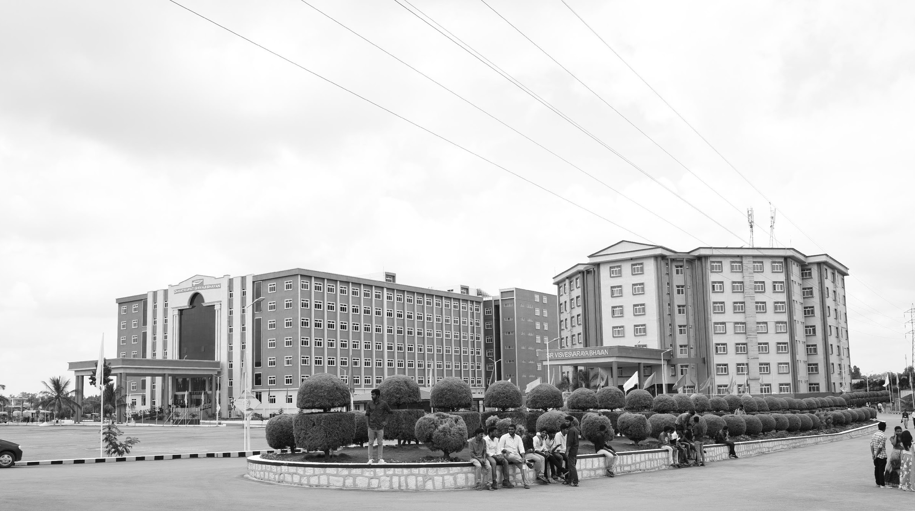

BuggyBrain’s – Intelligence Mobility with Real-Time Assistance
Mid-Review 1
Major Project
Project ID: A9
AY 2021-25
GITAM (Deemed-to-be) University
Project Team:
Saniya khanam(BU21EECE0100493)
K.Chowdeswari (BU21EECE0100343)
K.Monika (BU21EECE0100573)
Department of Electrical Electronics and Communication Engineering
Project Mentor:
Venkata Kranthi .B
Project In-charge:
Dr. Arun Kumar
www.gitam.edu

Slide 2
Abstract
Innovative AI Virtual Assistant: An AI-powered assistant designed to enhance productivity and convenience in controlled environments.
Developed with Raspberry Pi: Built using Raspberry Pi and advanced artificial intelligence technology.
Intelligent Mobility & Adaptive Learning: Combines mobility solutions with adaptive learning for a personalized, efficient user experience.
Natural Language Processing (NLP): Enables seamless, intuitive communication between the user and the system.
Object Detection: Utilizes AI to identify and interact with objects in the environment, enhancing functionality and user support.
Scalable Design: Built for scalability, allowing expansion and adaptation to new technologies.
Intelligent Mobility & Adaptive Learning: Combines mobility solutions with adaptive learning for a personalized, efficient user experience.

Slide 3
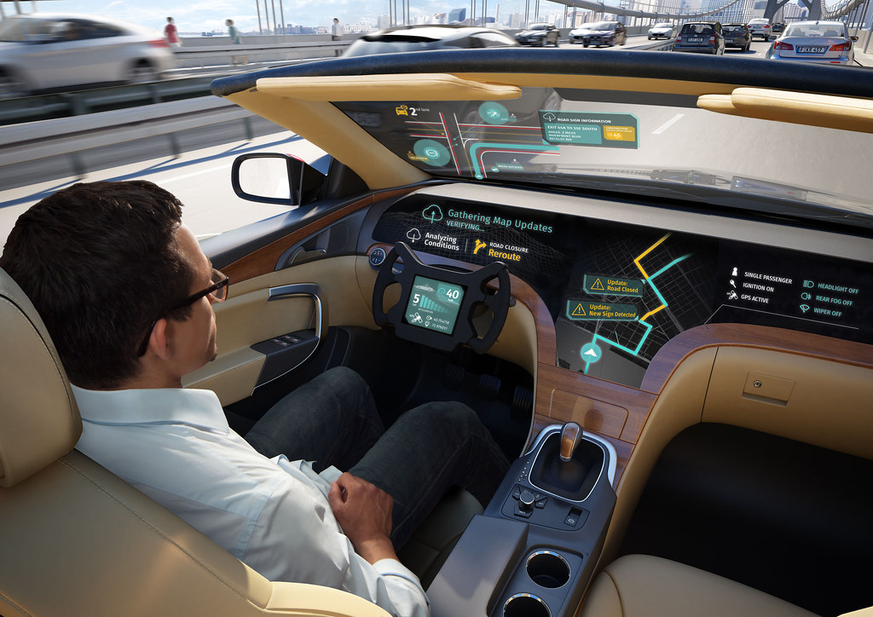
Objective and Goals
Objective
To create a real-time in-car assistant for electric vehicles to aid in safety via real-time detection of obstacles and collision warnings, optimize energy consumption through customized life of batteries and charging recommendations, enhance navigation through real-time traffic updates and close charging stations, predict maintenance needs through proactive notifications, and create highly personalized assistance by learning the driver's habits and preferences.
Goals
Main Goals
Enhance safety through real-time obstacle detection and collision warnings.
Optimize energy efficiency with personalized battery life and charging recommendations.
Improve navigation with real-time traffic updates and nearby charging station information.
Additional Goals
Seamless Navigation
Predictive Maintenance

Slide 4
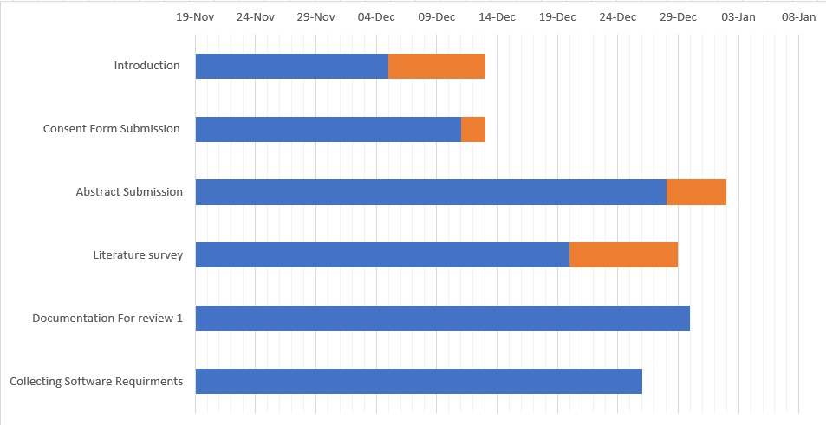
Project Plan
REVIEW 01

Slide 5
Literature Survey
TITLE | YEAR | AUTHOR | TECHNOLOGY | RESEARCH GAP
A Robust Real-Time Computing-based Environment Sensing System for Intelligent Vehicle | 2020 | Qiwei Xie, Qian Long, Liming Zhang, Zhao Sun | Machine Learning Object detection | Integration of Advanced Machine Learning Techniques Limitations of Current Detection Technologies
Smart Driver Assisting Vehicle System using Raspberry PI | 2018 | Prof. Amit Choksi , Prof. Kaushal Patel , Drupad Pandya , Yash Dave | Raspberry pi | Image Processing Techniques Real-time Decision Making
Design and Implementation of Autonomous Car using Raspberry Pi | 2015 | Gurjashan Singh Pannu, Mohammad Dawud Ansari, Pritha Gupta | Pi Camera OpenCV Raspberry Pi | Dynamic Obstacle Detection Environmental Adaptability Integration of Advanced Sensors
"AI Technology Brings Excitement to Nissan Japan“ | 2022 | Yoshinori Sato, Seiji Furuta, Shinichi Chiba | Machine Learning Image Recognition Technology | Scalability and Generalizability Human-AI Collaboration

Slide 6
Architecture
STEPS WHICH ARE INCLUDE FOR THE PROJECT” BUGGYBRAINS”
Raspberry pi Setup
Installation of Raspbian OS and libraries
Programming a Python Code
Connection > System Hardware
Deploy and Monitor
(Result)
Testing and Debugging
Insert APPLICATIONS
Optimize Performance
Passenger Interactions

Slide 7
Use Cases & Testing
Use Cases
Enhancing Security with Object Recognition
Actor: User (e.g., a host)
Goal: Monitor their autonomous place for moving activity or objects.
Preconditions: Buggy Brain is connected to a camera monitoring the front side ; web interface is accessible.
Relaxing with YouTube Music Playlists
Actor: User (e.g., a GITAM researcher)
Goal: Unwind after a long day with music from YouTube.
Preconditions: Buggy Brain web interface is open on a phone.
Test Cases
Object Detection Accuracy: Scenario: Place a object or a person (e.g., phone, book, human ) in front of Buggy Brain.
Expected Outcome: Correctly identifies object and provides verbal confirmation (e.g., "I see a cup").
Test Case 1.1: Verify access to the games section. Input: Log in, navigate to the "Games" tab or section on the dashboard.
Expected Output: Games section loads, displaying available games

Slide 8
Implementation and Results – Iteration 1
Iteration 1 :
Object Detection for : They type, "Scan the object or a person Infront of the screen"
Buggy Brain uses the Raspberry Pi camera to detect object or a person Infront of the screen“ through giving a signal .
Study Session with Games : Buggy Brain alerts: the screen to get rid of time .
During the session, they say, "Play a tic tac toe."
Buggy Brain launches a game,

Slide 9
Contribution
Team Progress and Movement
Xx
Xx
X
X
Individual Contribution
Key contributions: Team Member Name
XX
XX
Key contributions: Team Member Name
XX
XX
Key contributions: Team Member Name
XX
XX
Key contributions: Team Member Name
XX
XX
Key contributions: Team Member Name
XX
XX

Slide 10
Conclusion & Future Work
Summary and Conclusion
Future Work

Slide 11
THANK YOU
Have a Great Day !

